Slide 1

AI Final Project Part 1
Karely Rodriguez

Slide 2
Problem Overview
My virtual world is full of reactive cooperative AI agents navigating in a non-deterministic environment.
The goal was to move countries into states that represent development.
The agent relies on the state quality function, the search algorithms, and the expected utility used in determining which schedules are deemed better.
My focus was on getting a deep understanding of search algorithms.

Slide 3
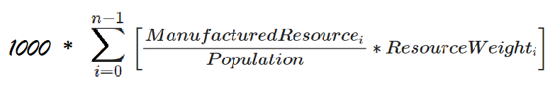
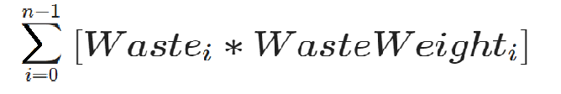
State Quality Function
Inspiration:
https://www.thebalancemoney.com/gdp-per-capita-formula-u-s-compared-to-highest-and-lowest-3305848
"The countries with the highest economic production per person have thriving economies and few residents.“
Natural Resource + Manufactured Resources + Waste
Reliant on a utility function that produces values between -10 and 10 depending on the ratio between number of natural resources and population.
The idea is more workers can increase production of natural resources
Utility is built based on these ideas:
Don't want too many resources and not enough workers
Don’t want too little resources and too much population
Want 3 to 8 times the amount of population
negative waste evaluation will be added apart from calculation because in the real world we subtly
ignore the accumulated waste and disregard it when viewing how great a country is
Focus is on how many people share access to these resources
Ideally looking for a low number of people sharing the same resource
This will be the most valuable portion to encourage development

Slide 4
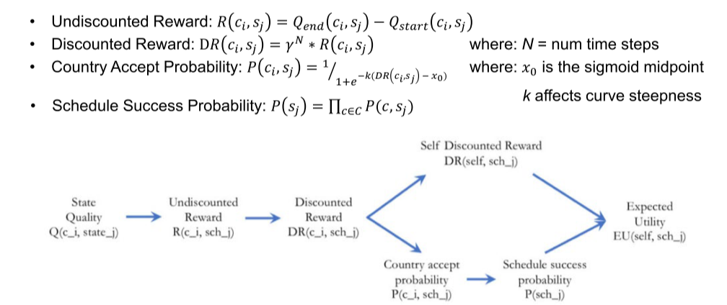
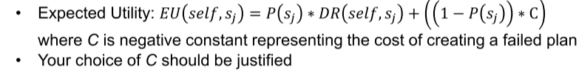
Interdependence between measures

Slide 5
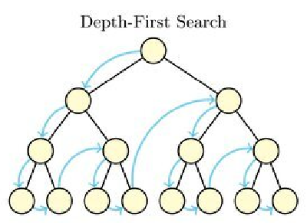
Heuristic Depth First Search
Recursive tree-based Depth First Search
Leaf nodes represent completed schedules
Priority Queue sorted on EU values and contains ONLY completed schedules
Limiting scope of search space
Frontier max size will limit amount schedules we can consider
Schedules are of length depth bound
Two Approaches:
Shallow depth bound & huge frontier max size
Deep depth bound & limited frontier max size
Note: Actions lists at each level is made of up shuffled transforms + shuffled transfers with total length of 43 possible actions

Slide 6
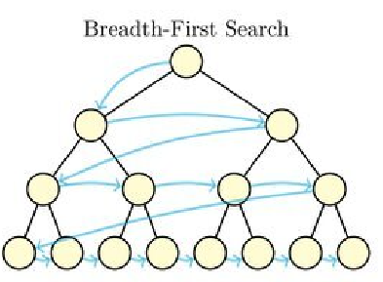
Greedy Best First Search
Recursive tree-based Greedy Best First Search
Priority Queue sorted on EU values and contains ONLY partial schedules
Reset at every level
Only best partial schedule will be explored
Limiting scope of search space
Frontier max size will limit number of actions explored, reducing breadth
Best schedule is of length depth bound
Limitations:
Frontier max size <= action length list
Note: Actions list at each level is made of up shuffled transforms + shuffled transfers with total length of 43 possible actions

Slide 7
Determining transform and Transfer quantities per action
Number of Transforms
return math.floor(random.uniform(0.5, 1) * max_num_of_transforms)
Resource Transfer Quantity
Resources with a high weight have a lower range used for randomly selecting the quantity to be transferred
We are only willing to give up a limited amount of high importance resources but, can spare more low weighted resources
Waste with lower negative weights will also be limited on how many can be transferred because we use the absolute value of the resource weight
return math.floor(random.uniform(0.1, 1 – abs(resource_weight)) * availableQuantities)

Slide 8
x0, k, gamma, and failure cost C Observations
K :
increasing to values around 5 had a negative effect
0.5 had a positive effect at the beginning but not consistently by the end
Trying very small values of K, around 0.001 yielded the most interesting results
X_0:
I did not notice too much of an impact for values around 0
The biggest change I noticed when I jumped to 10 but, that seemed too large and decided 5 produced fine results
Gamma:
0.1 countries always plateau quickest
0.5 I finally saw some very interesting effects
0.9 gave me such variety in the behavior of the countries
Failure Cost C:
-0.1 compared to -0.01 had more interesting results but still plateau
-0.2 and anything less did not do well
2 and greater did not do well either
-1 gave me the best results
Variable that produced good results
X_0: 5
K: 0.001
Gamma: 0.75
Failure Cost C: -1

Slide 9
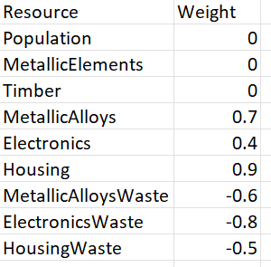
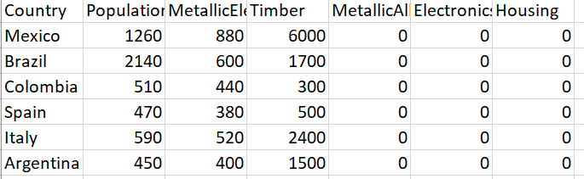
Initial States – Test Case 1
My goal was to have countries with a surplus, fair, and limited of natural resources. The numbers were calculated by roughly guesstimating the number of manufactured resources could be produced by the quantities to accommodate the population.

Slide 10
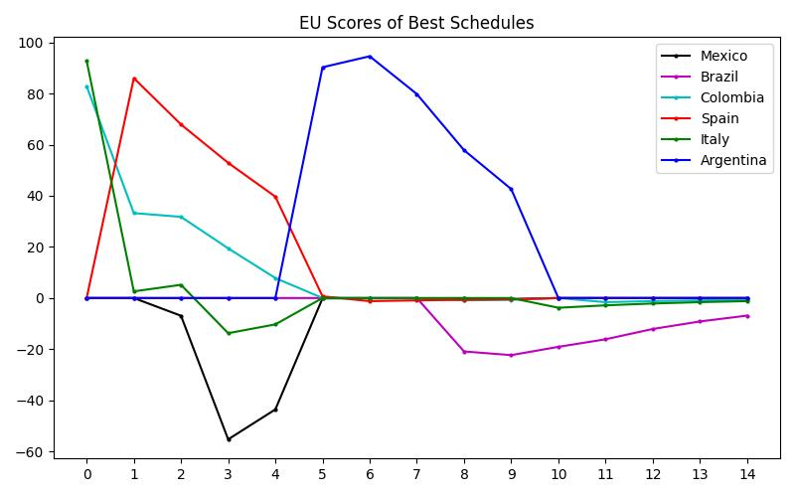
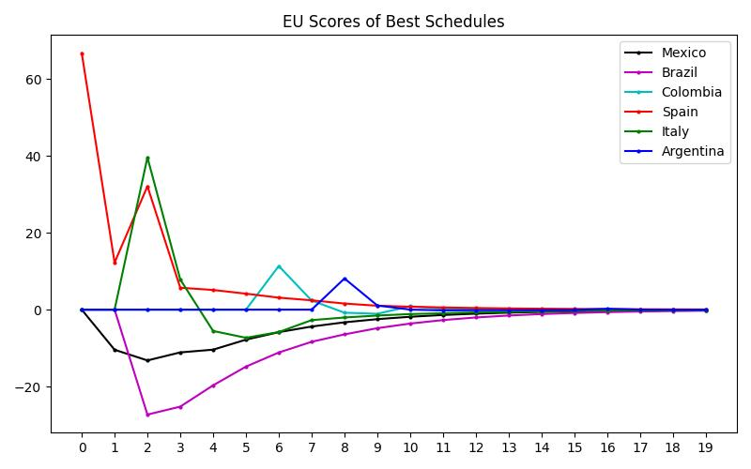
Heuristic Depth First Search Test
Shallow Depth bound: 5
Larger Max Frontier Size: 300
Deep Depth bound: 20
Small Max Frontier Size:10

Slide 11
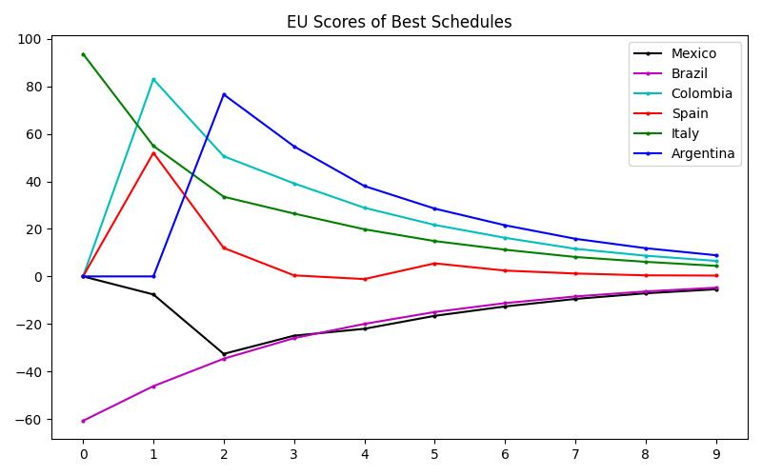
Greedy Best First Search Test
Depth bound: 15
Frontier Max Size: 20

Slide 12
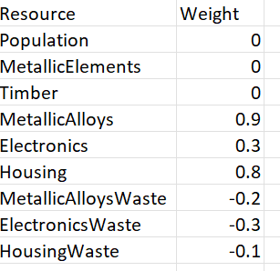
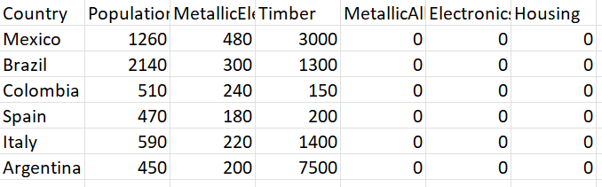
Initial States – Test Case 2
I reduced the amount of resource significantly to see if I can get better test cases for these small samples. Also, I decreased the negative waste significantly. The waste was opposing the positive effect of the manufactured resources.

Slide 13
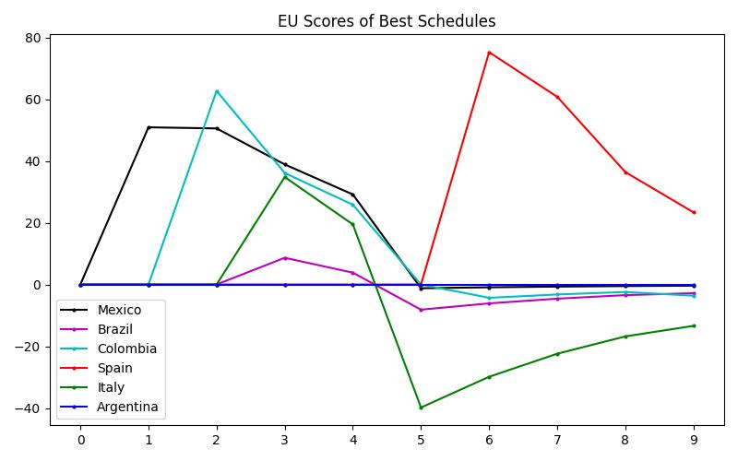
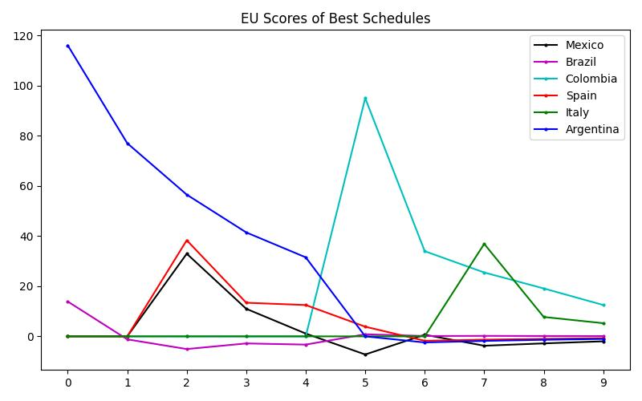
Heuristic Depth First Search Test
Shallow Depth bound: 5
Larger Max Frontier Size: 100
Deep Depth bound: 20
Small Max Frontier Size:10

Slide 14
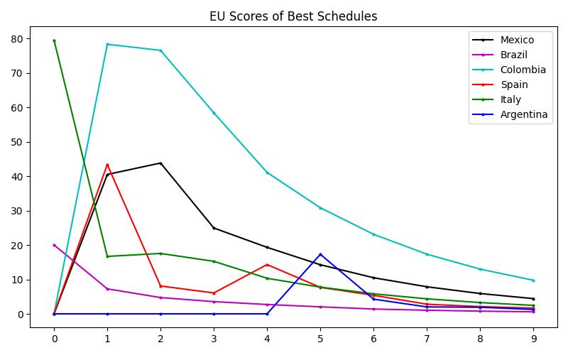
Greedy Best First Search Test
Depth bound: 15
Frontier Max Size: 20

Slide 15
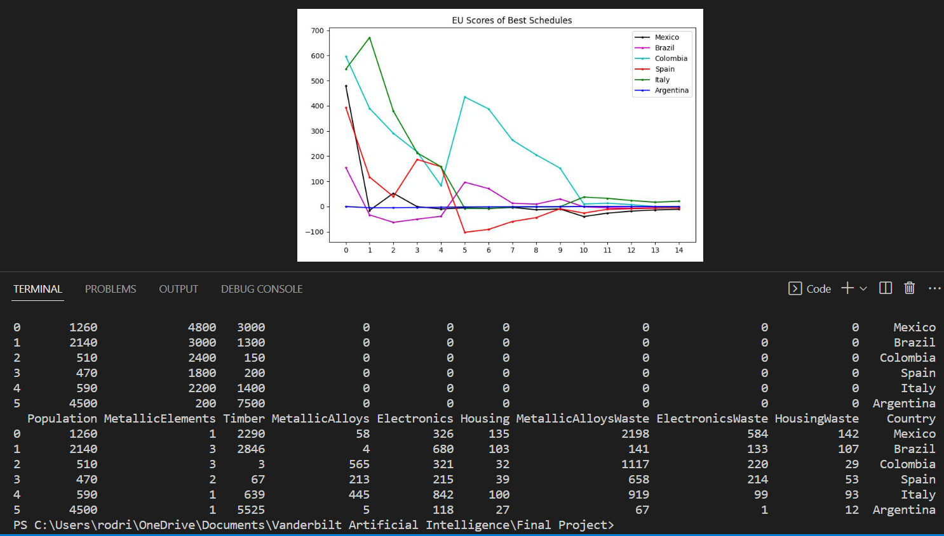
Final Test and thoughts

